Slide 1
Hand Sanitizer
BTW, I used my mom's makeup tubs to hold stuff. Don't laugh.
Sorry if there's not enough cool animations.
Genius Hour project by Melody Jin
I recommend you don't touch the stuff till you finish the slideshow. You need to know what slimy stuff to expect.

Slide 2
Our Sanitizers
Did you know that hand sanitizers are actually harmful to our health? Yes, they kill our germs, and they're really good at it, but the rubbing alcohol (a.k.a. ethyl alcohol or ethanol) that kills the germs also bothers our bodies.

Slide 3
So
So, I tried to make a hand sanitizer that doesn't hurt people but still works. This is how I did it.

Slide 4
Try One

Slide 5
What You Need and Why
This is the stuff I used. I got everything from Fred Meyers, but Walmart, Walgreens, or Target also have stuff.
Aloe Vera gel- it soothes and heals skin, and does the does some disinfecting
Tea tree oil (optional)- it moisturizes skin and cleans
Vitamin E oil (super optional)- Similar to tea tree oil
Essential oils (optional)- They're for scent, though the gel already smells. People use cinnamon a lot, for some reason, but I hate the smell.
Big green bottle- Aloe Vera gel.
Brown-topped yellow bottle- Tea tree oil.
Little black bottles- Essential oils (lemongrass, cinnamon, and lemon).
White-topped yellow bottle- Vitamin E.

Slide 6
Doing Stuff
1.
Mix 1/4 cup of Aloe Vera gel, 6-9 drops of essential oil, 6 drops of tea tree oil, and 2-5 drops of Vitamin E.
Remember, Vitamin E and the essential oils are optional.
First, the Aloe Vera gel. It was super thick.

Slide 7
2.
9 drops of cinnamon oil and 8 drops of lemon and lemongrass oil (you can't really smell the lemons, but the cinnamon is really strong). The gel turned paler and slimier.

Slide 8
3.
I added 6 drops of tea tree oil.

Slide 9
4.
I added 3 drops of Vitamin E oil. It's super slimy and oily. The gel turned firmer.

Slide 10
The Result

Slide 11
Reflection
The smell is super strong and spreads everywhere, but the smell doesn't last long on your hands.
I think the smell is funny. Kind of gross and weird.
What do you think?

Slide 12
Try Two

Slide 13
Differences
More oil. Also, there's different flavors, and I'll be putting less scent because it's so strong.

Slide 14
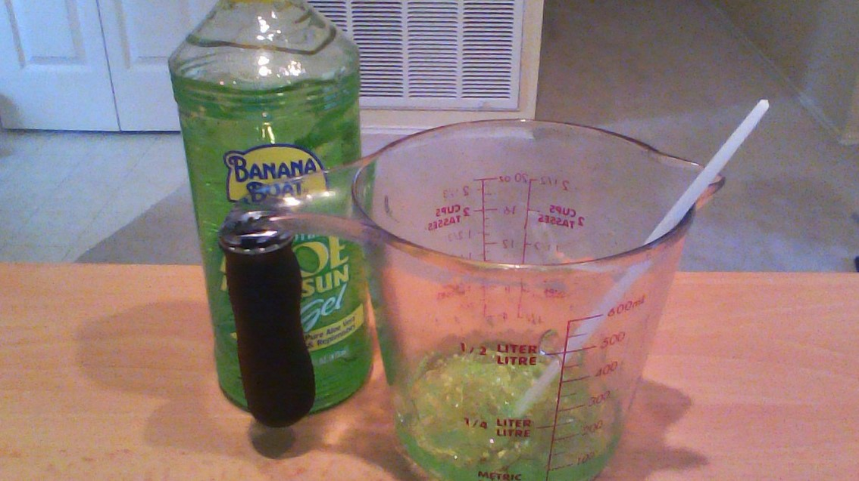
1.
Again, ¼ cup of Aloe Vera gel.

Slide 15
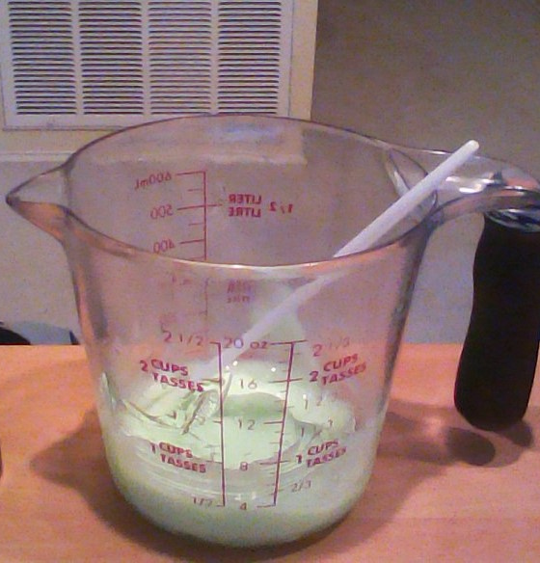
2.
6 drops of grapefruit and sweet orange essential oils, and 3 drops of peppermint essential oil.

Slide 16
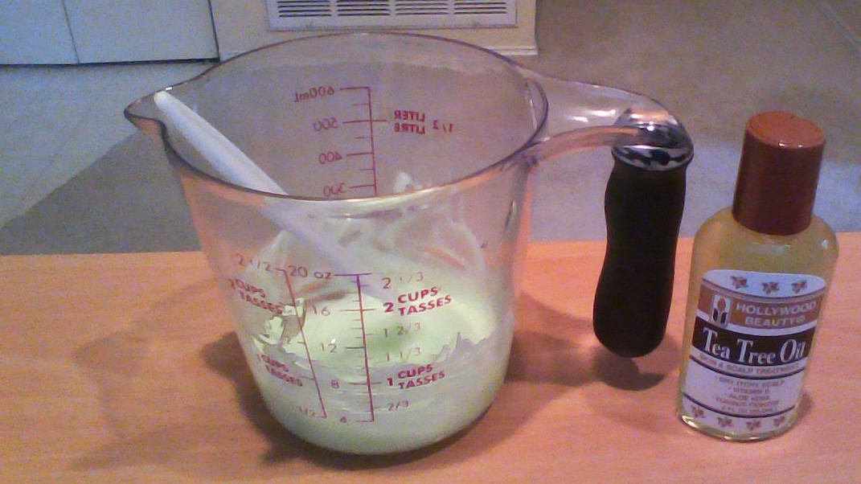
3.
10 drops of tea tree oil. To keep stuff smooth.

Slide 17
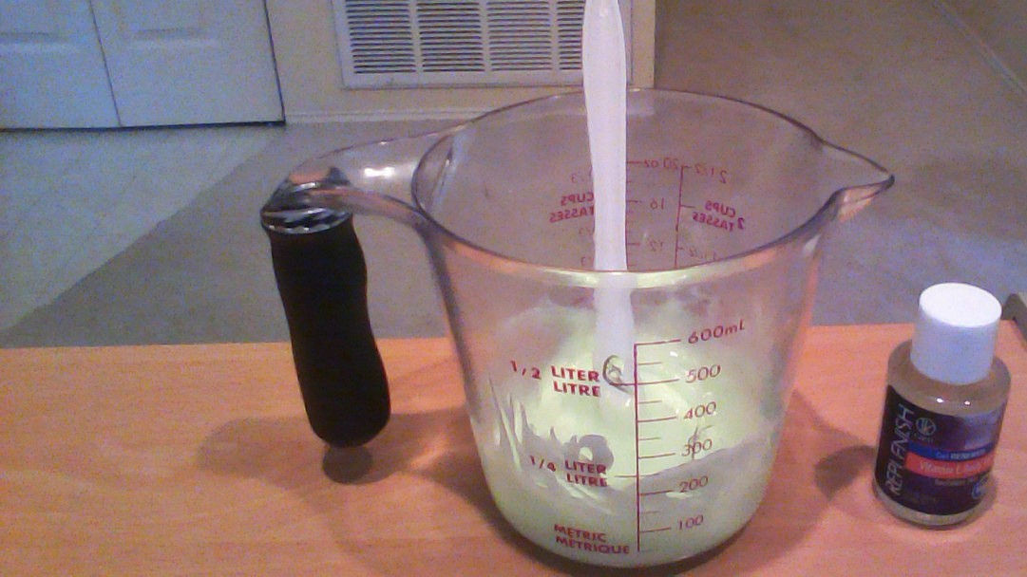
4.
3-4 drops of vitamin E oil to thicken stuff up.

Slide 18
The Result
The smell is nice and faint. But the sanitizer is SOOO sticky and oily. The stickiness goes away fast though.

Slide 19
All-of-It Reflection
These smells are nice, but it's not like the sweet fruity smells in other sanitizers.
It's not pretty. Food coloring would've been nice.
No glitter, no matter how nice it looks. Glitter is harmful for you and the environment, did you know?

