Slide 1
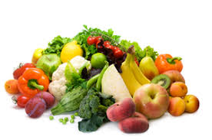
Healthy
Your elixir for a happy life
Eats
By: Bella and Ayush

Slide 2
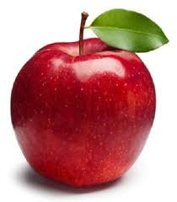
Class.. We have a problem
We have an Obesity Epidemic. The future of the nation is bad and getting worse as obesity takes its toll on the health of adults and children alike.
Recent reports project that by 2030, half of all adults (115 million adults) in the United States will be obese. Obesity-related illness, including chronic disease, disability, and death, is estimated to carry an annual cost of $190.2 billion
US adults consume an average of 3,400 mg/day [of sodium], well above the current federal guideline of less than 2,300 mg daily
About 90% of Americans eat more sodium than is recommended for a healthy diet. Reducing the sodium Americans eat by 1,200mg per day could save up to $20 billion a year in medical costs.
28.0% of Americans, or 80.2 million people, aged six and older are physically inactive.
Your elixir for a happy life
What are we going to do?

Slide 3
How does the this work?
Our App helps people eat healthier by allowing them to make healthy choices!
Healthy Eats encourages good and healthy eating habits by providing an easy way to plan what to eat and by showing data on the calorie intake.
The App has the following features
(a) A scheduling page where the user can plan what they want to eat in the future
(b) A logging page where you can log what you actually ate instead of what was on the plan (if you didn’t follow the schedule)
(c) A healthy recipe page to give recipes for healthy food (This is WIP)
(d) A catalog page where you can view the calories of various food (This is WIP)
(e) A reports page that shows the statistics of the calories that was consumed each day (This is WIP)

Slide 4
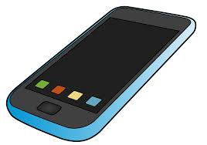
How we created this App
https://scratch.mit.edu
https://phosphorus.github.io/
https://www.appsgeyser.com/
phosphorus
First we created a Scratch project, then the real coding begins
Well there is this really neat website called Phosphorus that packages our scratch project and turns It into JavaScript(also known as JS, a programing language)
Then I used another great website called appsgeyser that compiles our JS to an app that is released on the Amazon Appstore!​
You may be thinking "why make a scratch project? I thought you were making an app?

Slide 5
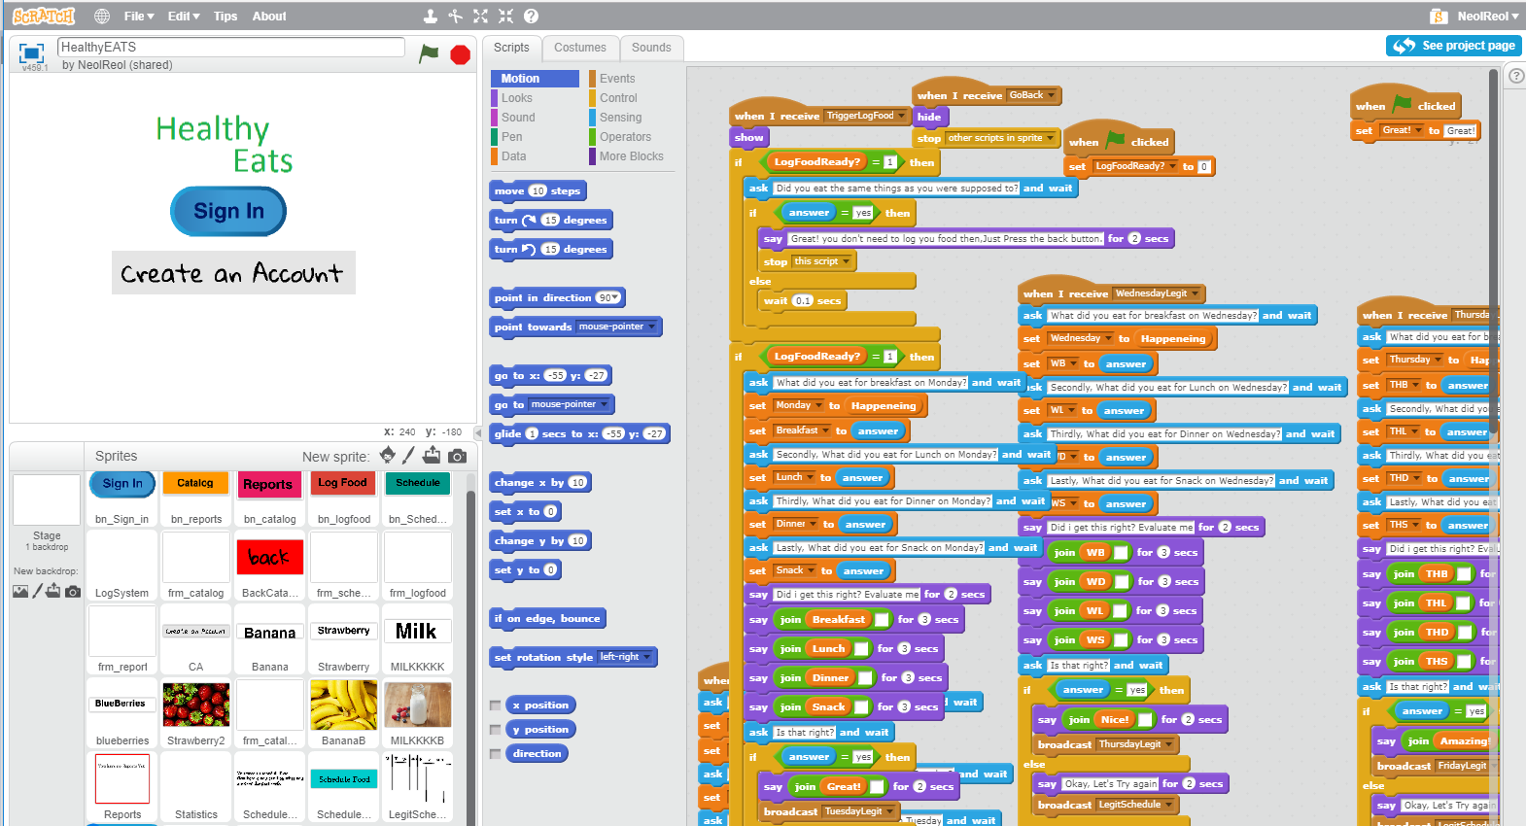
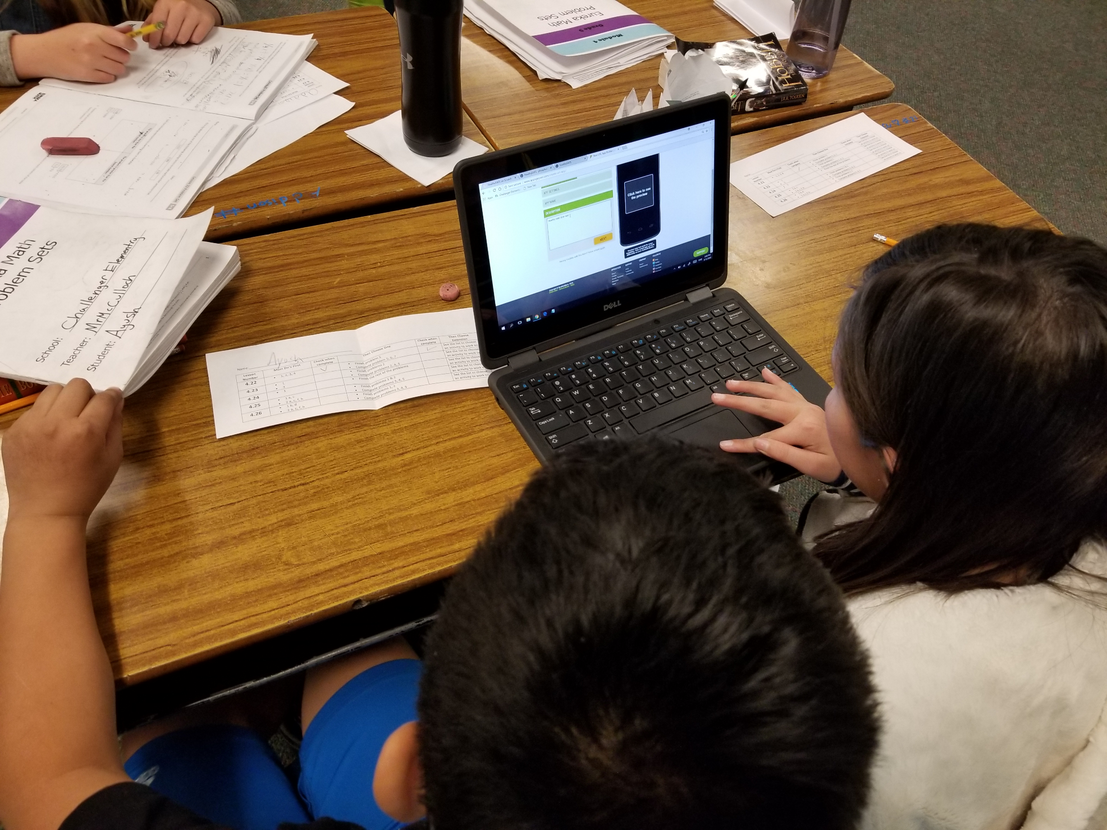
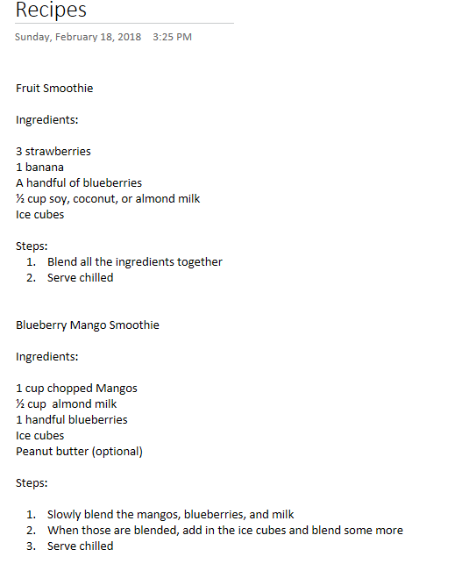
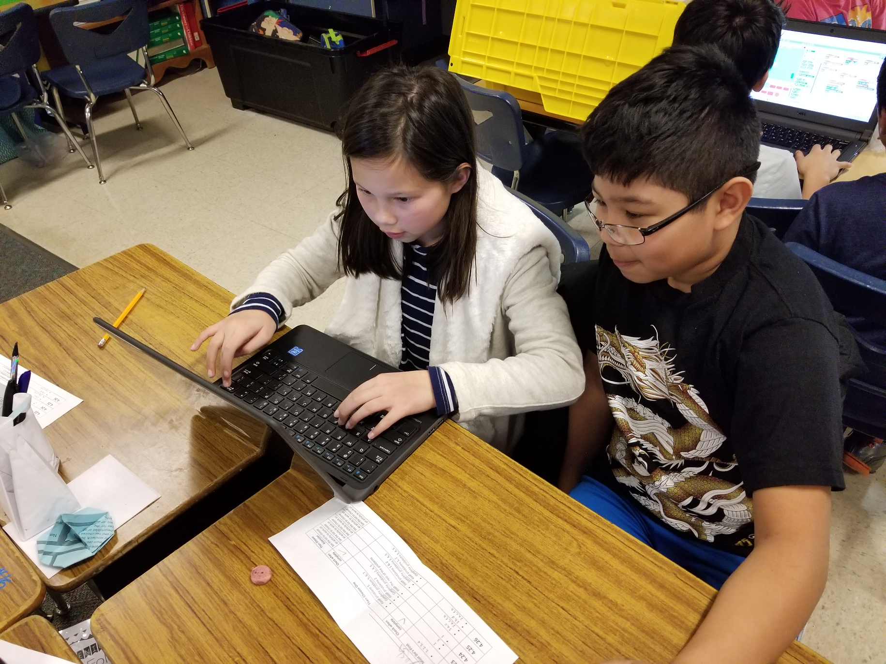
Working hard for the nation!

Slide 6
Thank you for listening!
Remember to stay healthy at all times
Veggies
Eat healthy
Dairy
Fruit

